Slide 1
Facial Recognition Software
Shawn Arthur, Zac Comer, Liam Davis-Wallace, Seshadri Kakani, Hangyul Kim, Fareeza Zameer

Slide 2
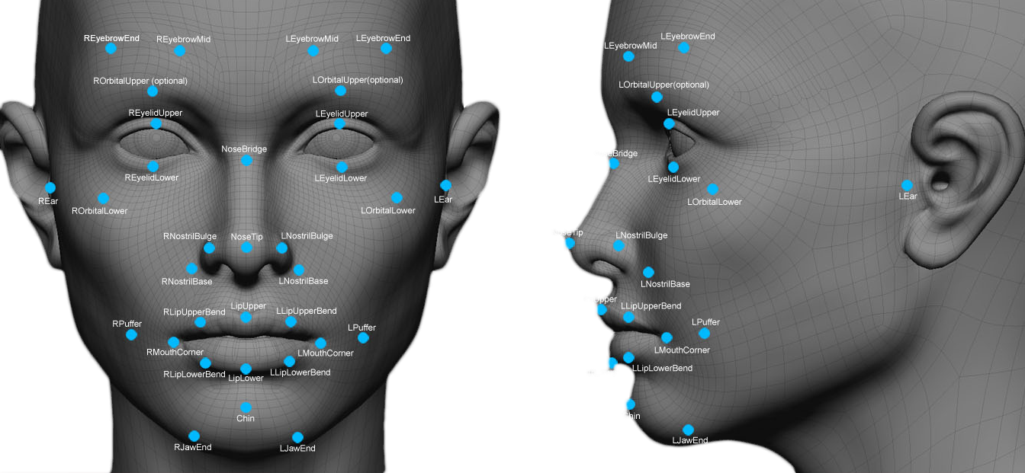
Background
Software that identifies people based on their facial features
Identifies “facial landmarks” to distinguish different faces
Compares facial landmark data to a database to match the face
Uses machine learning
Notes:
Liam Davis-Wallace
“What is facial recognition software? FRC is software that identifies people’s faces based on particular features identified by a camera”

Slide 3
History of Facial Recognition
1960’s
Woody Bledsoe, Helen Chan Wolf and Charles Bisson started to use computers for an early version of facial recognition
Used manual methods to find distances between facial features, then the measurements were uploaded to the computer.
1970’s
Added 21 markers to improve the accuracy of facial recognition
Still used manual processes for labeling facial features
1980-90’s
Linear Algebra was used to improve the accuracy of facial recognition
Able to detect faces in images, creating automatic facial recognition

Slide 4
History of Facial Recognition
1990-2000’s
Defence Advanced Research Projects Agency (DARPA) and the National Institute of Standards and Technology (NIST) rolled out the Face Recognition Technology (FERET) programme to encourage the commercial facial recognition market.
Created a test set of 2,413 images representing 856 people
The NIST developed Face Recognition Vendor Tests (FRVT) to help evaluate commercial facial recognition software
Face Recognition Grand Challenge(FRGC) used to develop the latest facial recognition algorithms
Social Media started to use facial recognition

Slide 5
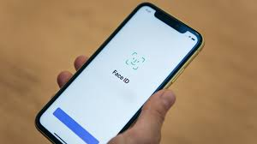
Facial recognition software today
Widely used and becoming accessible
Apple’s FaceID
Clearview AI
Approved for a federal patent
Scrapes public images on social media to find matches
Notes:
Liam Davis-Wallace

Slide 6
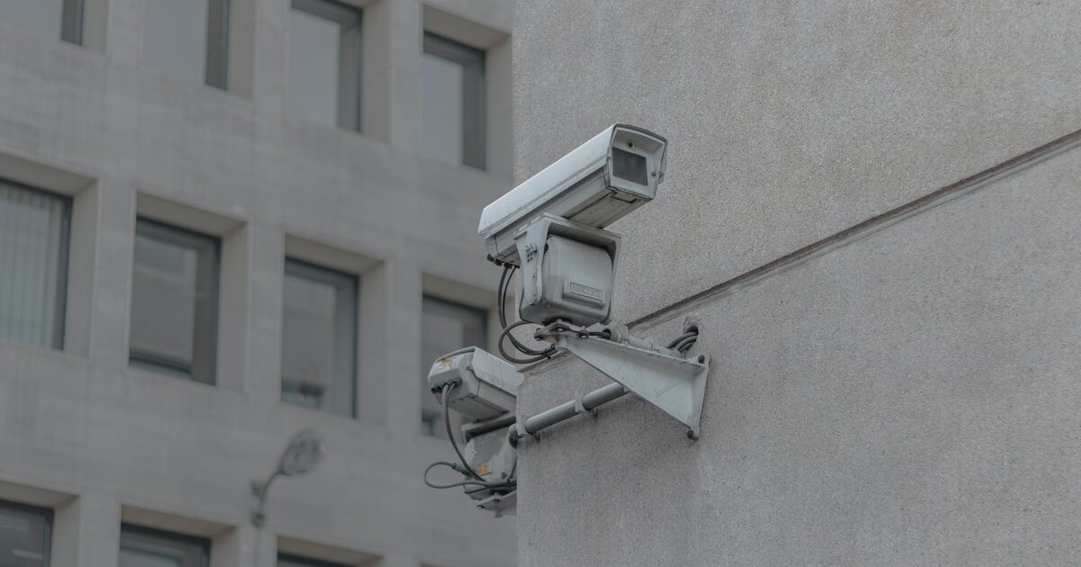
Use Case: COVID-19 Tracking
Bucheon, South Korea
Recording people who passing CCTV
Track movement of infected
People who do not wear mask
Privacy Problem
Monitoring citizens

Slide 7
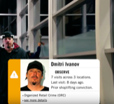
Use case: Preventing retail crime
Used to identify known shoplifters
Photographs of individuals can be matched against large databases of criminals
Loss prevention and security professionals can be instantly notified when a shopper enters a store that prevents a threat

Slide 8
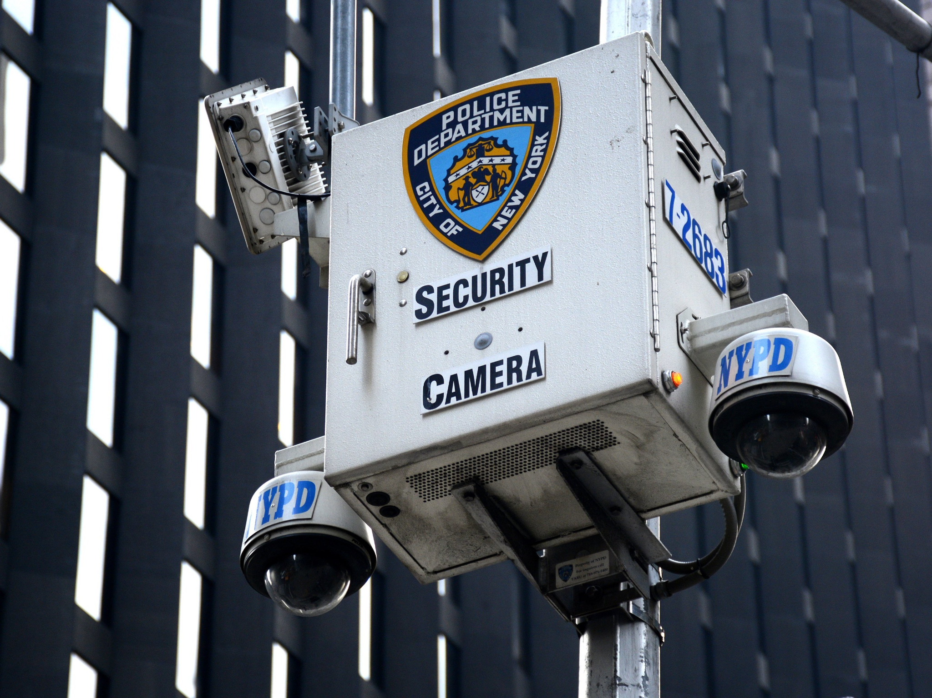
Dangers of Facial Recognition
Police Use of Facial Recognition
Can lead to incorrect identification and arrests
Studies have shown that facial recognition technologies perpetuate racial discrimination
Public has to relinquish any sense of privacy leading to potential abuses

Slide 9
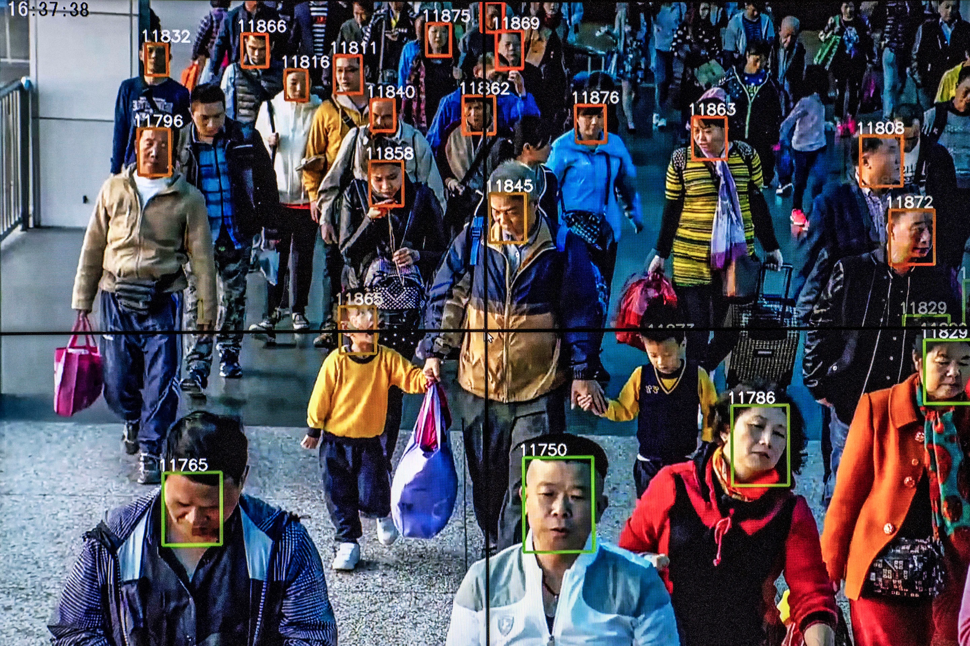
Dangers of Facial Recognition
Social control
Mass surveillance of the public to identify those who act against the government’s wishes
Collecting data on individuals to sell for advertising or other purposes

Slide 10
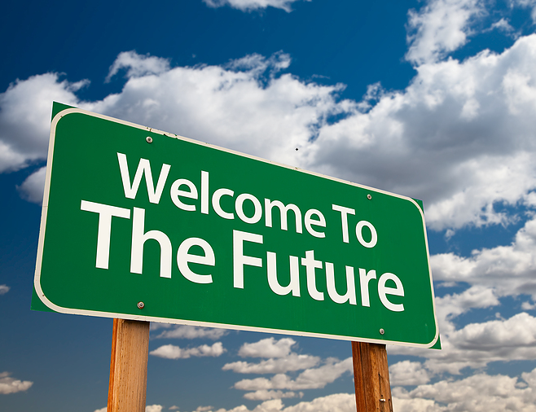
Future of Facial Recognition
Juniper Research shows that facial recognition hardware grows by 50% each year.
Facial recognition solutions are expected to be present in 1.3 billion mobile devices by 2024
COVID-19 has been one of the greatest accelerators of facial recognition technology

Slide 11
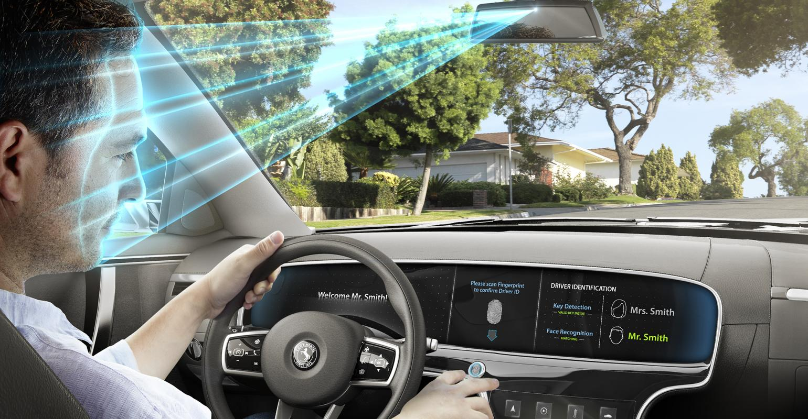
Automobile Industry
$6 Billion lost in the US to automobile theft.
Permissions and restrictions for family members
Unauthorized usage will block the car from starting
Iris recognition Driver State Warning System to keep drivers focused on the road

Slide 12
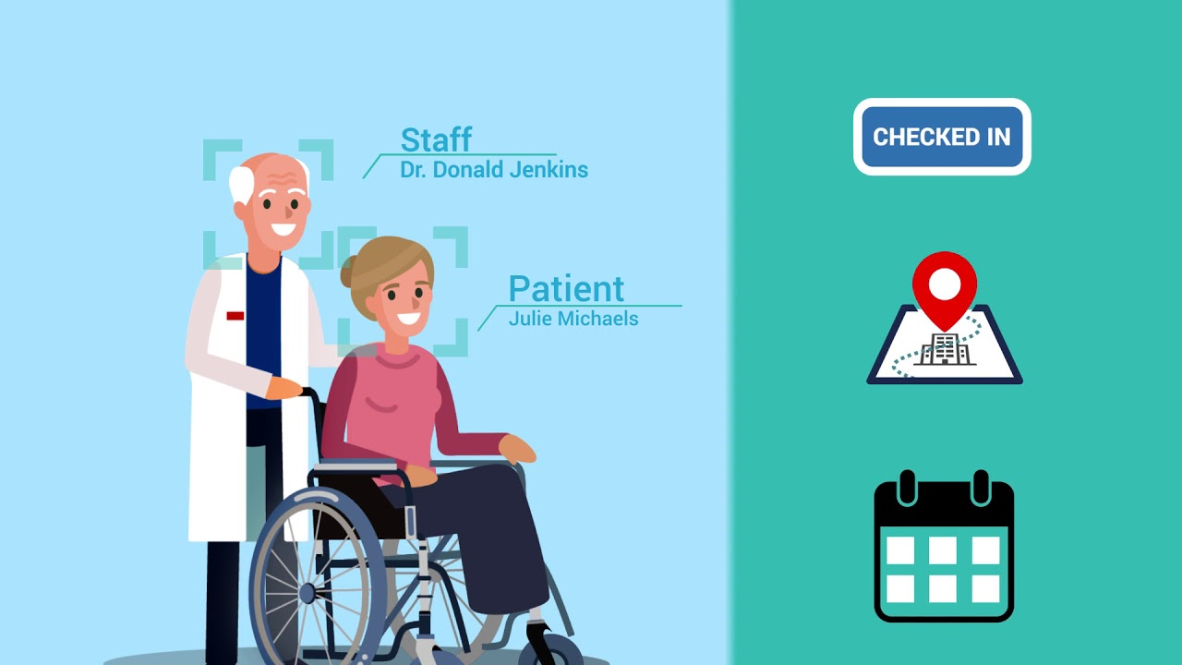
Healthcare
Improvements to overall safety standards
Reduction in identification errors
Patient monitoring and diagnosis

Slide 13
References
https://www.nec.co.nz/market-leadership/publications-media/what-is-the-future-of-facial-recognition-technology-in-2022-and-beyond/#:~:text=Facial%20recognition%20solutions%20are%20expected,other%20high%2Dend%20authentication%20tasks.
https://www.reuters.com/world/asia-pacific/skorea-test-ai-powered-facial-recognition-track-covid-19-cases-2021-12-13/
https://www.politico.com/news/2021/12/04/clearview-ai-facial-recognition-523735
https://www.cnet.com/news/politics/in-china-facial-recognition-public-shaming-and-control-go-hand-in-hand/

